Slide 1









Review: layers in OSI, TCP/IP & CSE
7th Application Layer
Application Layer
End-to-End Layer
6th Presentation Layer
5th Session Layer
4th Transport Layer
Transport Layer
3th Network Layer
Network Layer
Network Layer
2nd Link Layer
Link Layer
Link Layer
1st Physical Layer
OSI
TCP/IP
CSE

Slide 2
The link layer
The bottom-most layer of the three layers
Responsible for moving data directly from one physical location to another
  Physical transmission
  Framing bits & bit sequences
  Detecting transmission errors
  Multiplexing the link
  Providing a useful interface to the up layer

Slide 3
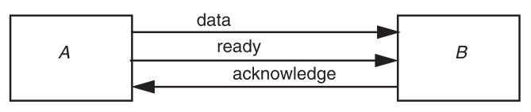
Transmitting digital data
Three-wire ready/acknowledge protocol
  A places data on data line
  A changes value on the ready line
  B sees the ready line change, reads value on the data line, then changes the acknowledge line
  B: when to look at the data line?
  A: when to stop holding the bit value on the data line?

Slide 4
Parallel vs. serial
Propagation time ∆t
  It takes more than 2∆t to send one bit
  The max data rate is 1/(2∆t)
Parallel transmission
  Use N parallel data lines to achieve N/(2∆t)
  E.g. SCSI, printer, etc.
Serial transmission
  Higher rates, longer distance, fewer wires

Slide 5
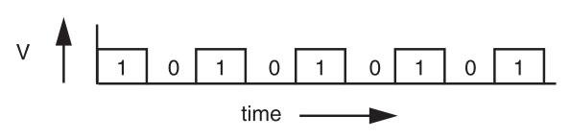
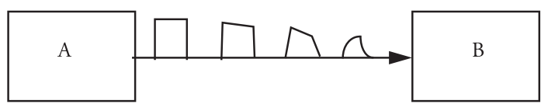
Signal transmission on analog line
It is hard for B to understand the signal

Slide 6
VCO & Manchester code
VCO: Voltage Controlled Oscillator
  Sender and receiver agree on an approximate data rate
  The receiver runs a VCO at about the same data rate
  phase-locked loop: locked VCO becomes a clock source
Problem: no transitions in the data stream
  E.g. a long string of zeros, phase-locked loop can’t sync
  Solution: sender encodes the data to ensure transitions
    Phase encoding: at least 1 level transition for a bit
    Manchester code: 0 -> 01, 1 -> 10
      Max data rate is only half, but simple enough
    Other encoding: 1 level transition for every few bits
Notes:
压控振荡器

Slide 7
Achieve the highest data rate
The arriving data signal is just on the ragged edge of being correctly decodable
Any noise on the line will show up in the form of clock jitter or signals that miss expected thresholds, either of which

Slide 8

Max possible channel capacity
Perfect analog channel
  Has infinite capacity for digital data
Shannon’s capacity theorem:
  C = channel capacity,
  in bits per second
  W = Analog bandwidth, in hertz
  S = maximum allowable signal power, as seen by the receiver
  N = noise power per unit of bandwidth
  Signal-to-noise ratio

Slide 9
Useful for estimating
  When W=1, log2(1 + S/N) is the max bits per second per Hz
  For a 28Kbps modem over the 2.4 KHz, must transmit 12 bits per second per Hz, so the signal-to-noise ratio must be 2^12 (36 db)

Slide 10
Framing frames
Where a frame begins and ends
Independent from framing bits
  That’s why some model separates link layer to two: one for bits and one for frames
Simple method
  Choose some pattern of bits, e.g. seven one-bits in a row, as a frame-separator mark
  Bit stuffing: if data contains six ones in a row, then stuffs an extra bit (0) into the stream

Slide 11
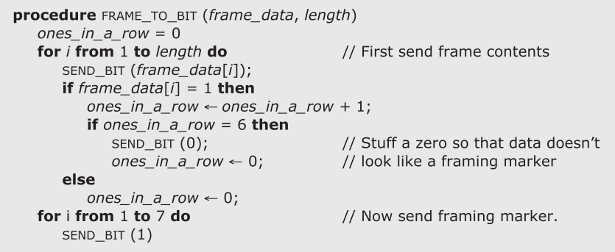
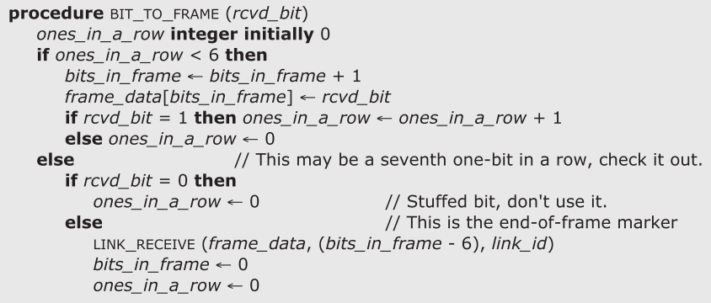
Notes:
(For simplicity, the illustrated receive proce- dure ignores two important considerations. First, the receiver uses only one frame buffer. A better implementation would have multiple buffers to allow it to receive the next frame while processing the current one. Second, the same thread that acquires a bit also runs the network level protocol by calling LINK_RECEIVE ably NOTIFY. A better implementation would prob-a separate thread that would then call the higher-level protocol, and this thread could continue processing more incoming bits.)

Slide 12
Error handling
Error detection code
  Adding redundancy
  Checksum at the end
What to do if detect an error
  Error correction code: with enough redundancy
    Where noise is well understood, e.g. disk
  Ask sender to resend: sender hold frame in buffer
  Let receiver discard the frame
  Blending these techniques

Slide 13


Coding: incremental redundancy
Forward error correction
  Perform coding before storing or transmitting
  Later decode the data without appealing to the creator
Hamming distance
  Number of 1 in A ⊕ B , ⊕ is exclusive OR (XOR)
  If H-distance between every legitimate pair is 2
    000101, can only detect 1-bit flip
  If H-distance between every legitimate pair is 3
    Can only correct 1 bit flip
  If H-distance between every legitimate pair is 4
    Can detect 2-bit flip, correct 1-bit flip

Slide 14
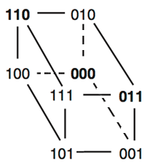
Examples-1
Example-1: simple parity check
  2 bits -> 3 bits
  Detect 1-bit errors
  Only 4 correct patterns ⊕
    00 -> 000
    11 -> 110
    10 -> 101
    01 -> 011
  Hamming distance of this code is 2
    1-bit flipping will cause incorrect pattern

Slide 15
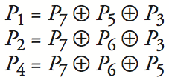
Example-2
4 bits -> 7 bits (56 using only extra 7)
  3 extra bits to distinguish 8 cases
  e.g. 1101 -> 1010101
Correct 1-bit errors
  1010101 -> 1010001 : P1 & P4 not match
  1010101 -> 1110101 : P2 not match
Not Match | Error
None | None
P1 | P1
P2 | P2
P4 | P4
P1 , P2 | P3
P1 , P4 | P5
P2 , P4 | P6
P1 , P2 , P4 | P7
1
0
1
0
1
0
1
1
0
1
0
1
0
1
1
0
1
0
1
0
1

Slide 16
Link layer interface
LINK_SEND (data_buffer, link_identifier)
LINK_SEND (data_buffer, link_identifier,
link_protocol, network_protocol)
Use different link protocol on a given link
  E.g. wireless link switches to a “robustness” protocol
Use different network protocol on a given link
  E.g. IP, Appletalk, ARP using the same link
  Sender may add it to the link-level packet header
  Receiver exams the field of header

Slide 17
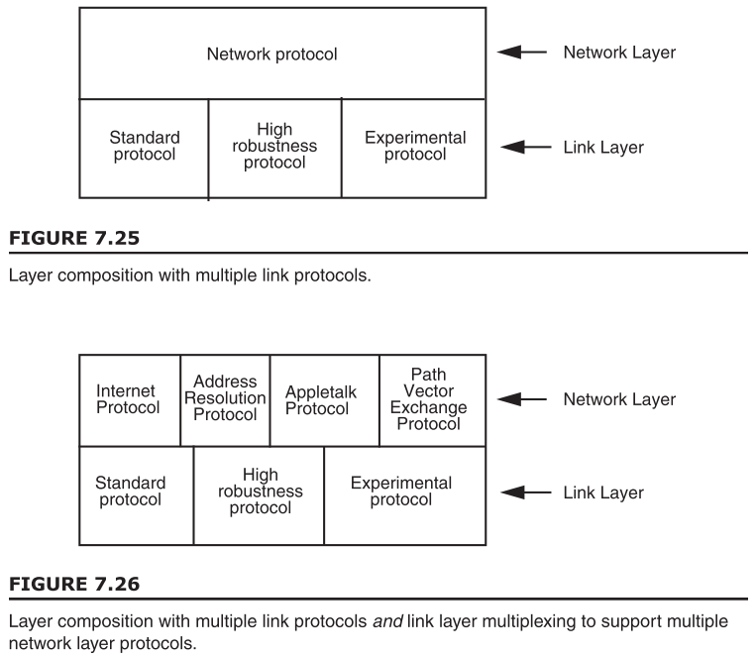

Slide 18
Link layer interface
structure frame
structure checked_contents
bit_string net_protocol //multiplexing parameter
bit_string payload // payload data
bit_string checksum

Slide 19
Link layer interface
procedure LINK_SEND (data_buffer, link_identifier,
link_protocol, network_protocol)
frame instance outgoing_frame
outgoing_frame.checked_contents.payload ←- data_buffer
outgoing_frame.checked_contents.net_protocol ←--
data_buffer.network_protocol
frame_length ← LENGTH (data_buffer) + header_length
outgoing_frame.checksum ← CHECKSUM (
frame.checked_contents, frame_length)
sendproc ← link_protocol[that_link.protocol]
sendproc (outgoing_frame, frame_length,
link_identifier) // Send frame.

Slide 20
Link layer interface
procedure LINK_RECEIVE (received_frame, length, link_id)
frame instance received_frame
if CHECKSUM (received_frame.checked_contents, length)
= received_frame.checksum
then // Pass good packets up to next layer.
good_frame_count ← good_frame_count + 1;
GIVE_TO_NETWORK_HANDLER (
received_frame.checked_contents.payload,
received_frame.checked_contents.net_protocol);
else bad_frame_count ← bad_frame_count + 1 // Just
count damaged frame.

Slide 21
// Each network layer protocol handler call SET_HANDLER before the first packet for that protocol arrives…
procedure SET_HANDLER (handler_procedure,
handler_protocol)
net_handler[handler_protocol] ← handler_procedure
procedure GIVE_TO_NETWORK_HANDLER (received_packet,
network_protocol)
handler ← net_handler[network_protocol]
if (handler ≠ NULL) call handler(received_packet,
network_protocol)
else unexpected_protocol_count ←
unexpected_protocol_count + 1

Slide 22
Link properties
Link types
  A point-to-point link
    Directly connects exactly two entities
  Simplex link & duplex link
  Half-duplex link & full-duplex link
  Broadcast link
    WiFi: one transmitter at a time, CDMA: many transmitter
Why MTU (Maximum Transmission Unit)?
  Error handling, packet discard, hardware buffer limit
Simplex
link
Full-Duplex
link
Half-Duplex
link

